Slide 1
LondonAQ
Rookie

Slide 2
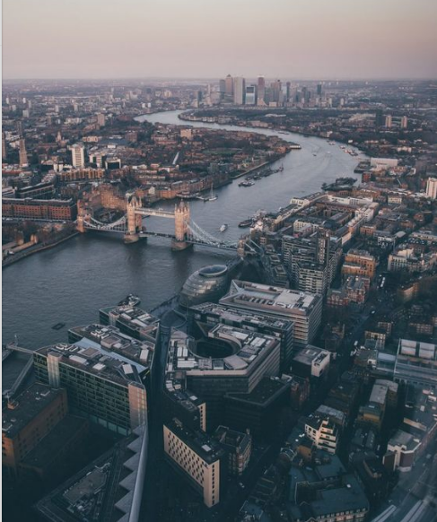
Background
Background
In London, 9,400 premature deaths are attributed to poor air quality and a cost of between £1.4 and £3.7 billion a year to the health service. – London Councils

Slide 3
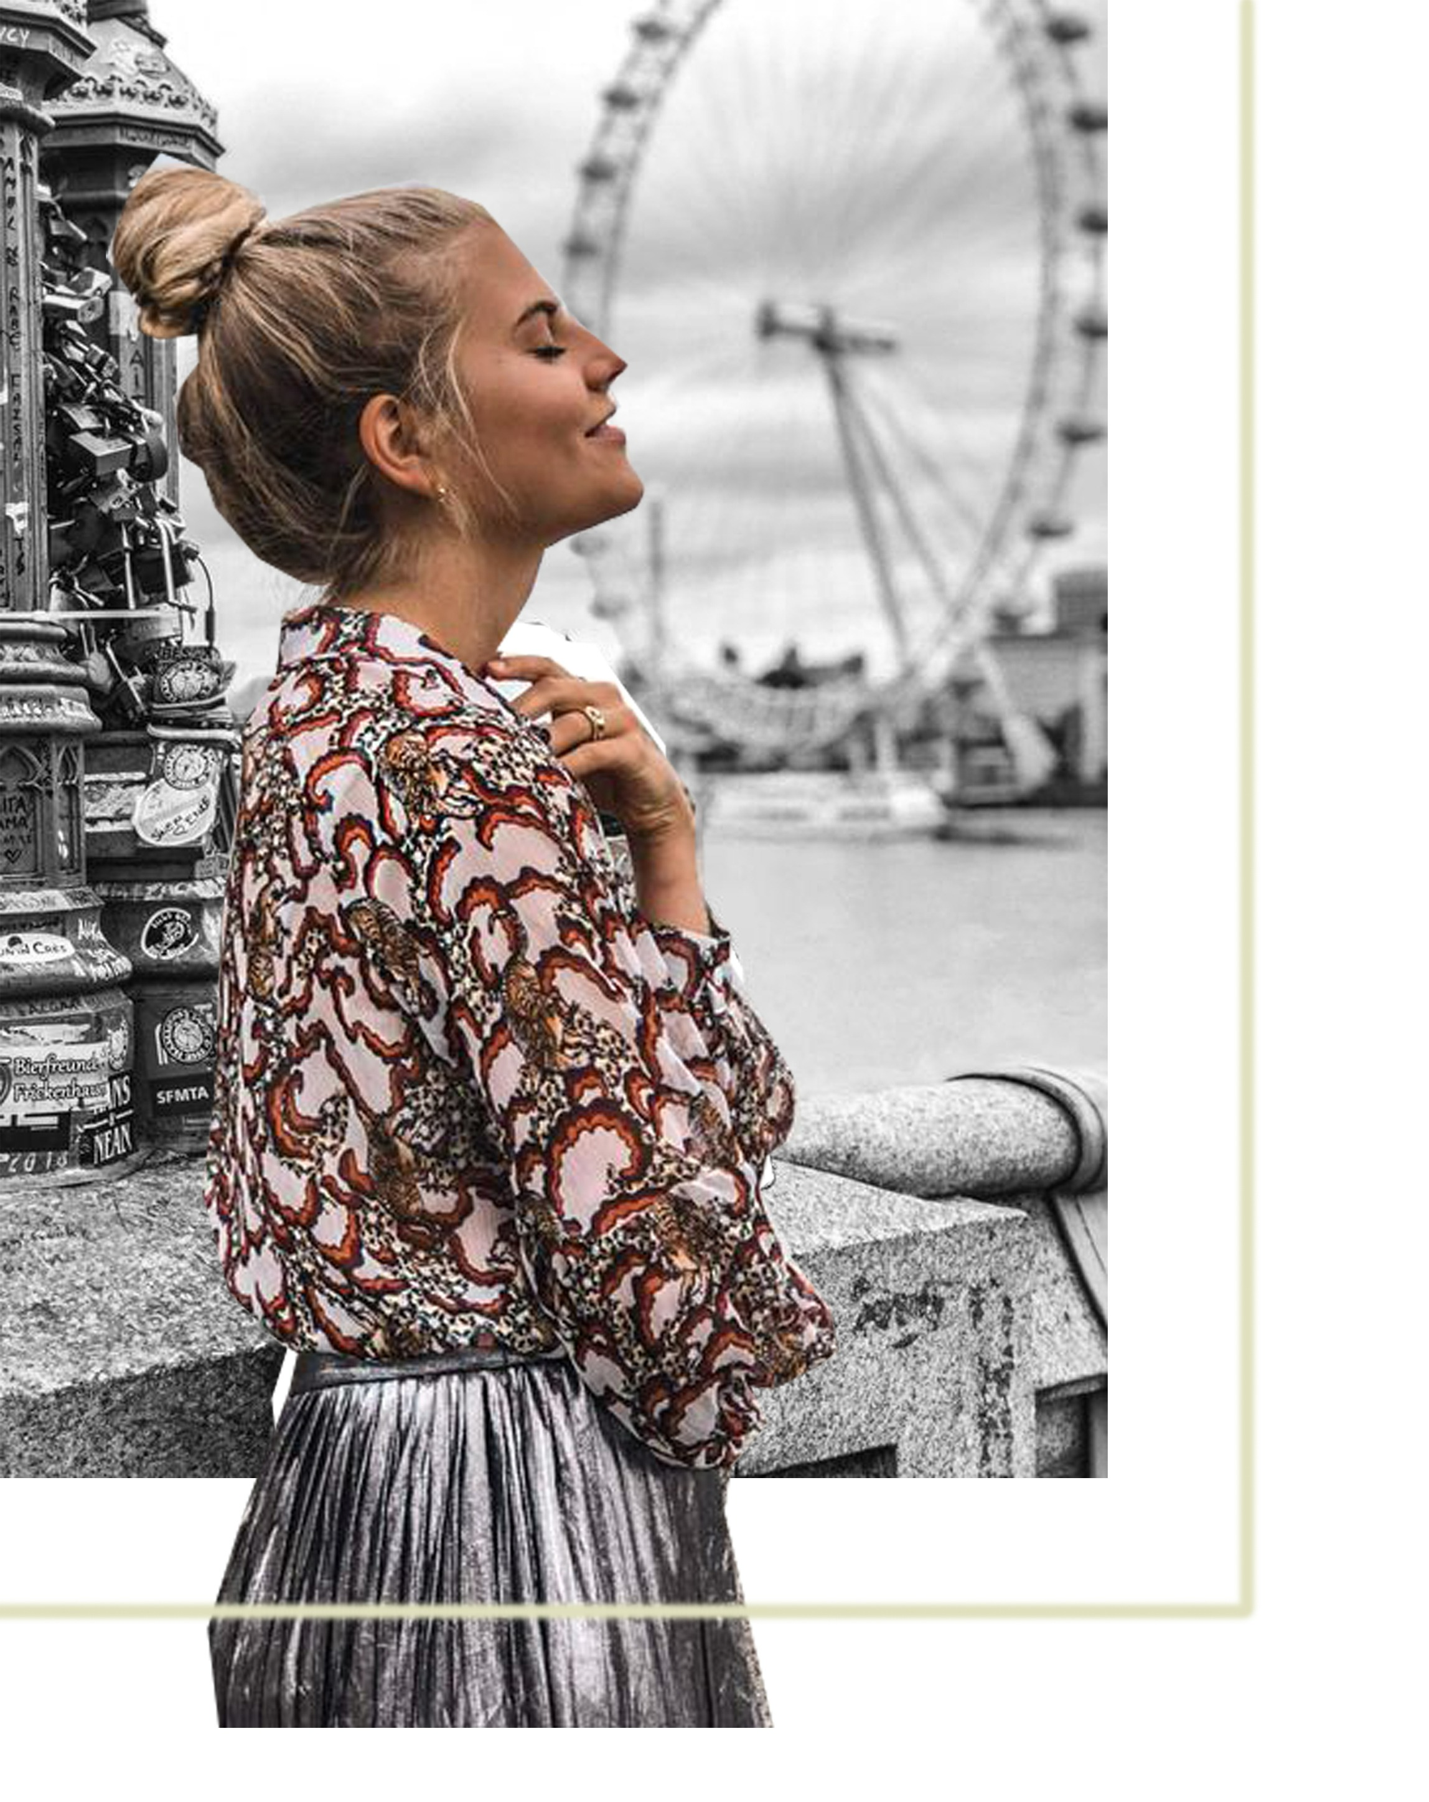

Needs
Needs: 1/ I wish there was a software that could react to the air quality in London in real time.
2/ I wish it was something intuitive, too many complicated numbers make me can't focus on.
3/ I want it to be something with a sense of design.
I'm Anna,
a designer in London.
Needs: 1/ I would like to have a software that can reflect the real-time data of London air quality, the source of the data must be real.
2/ I often don't know where some places are, it may be more convenient for me to know its approximate location if there is a model.
I'm Joe,
a newcomer in London

Slide 4
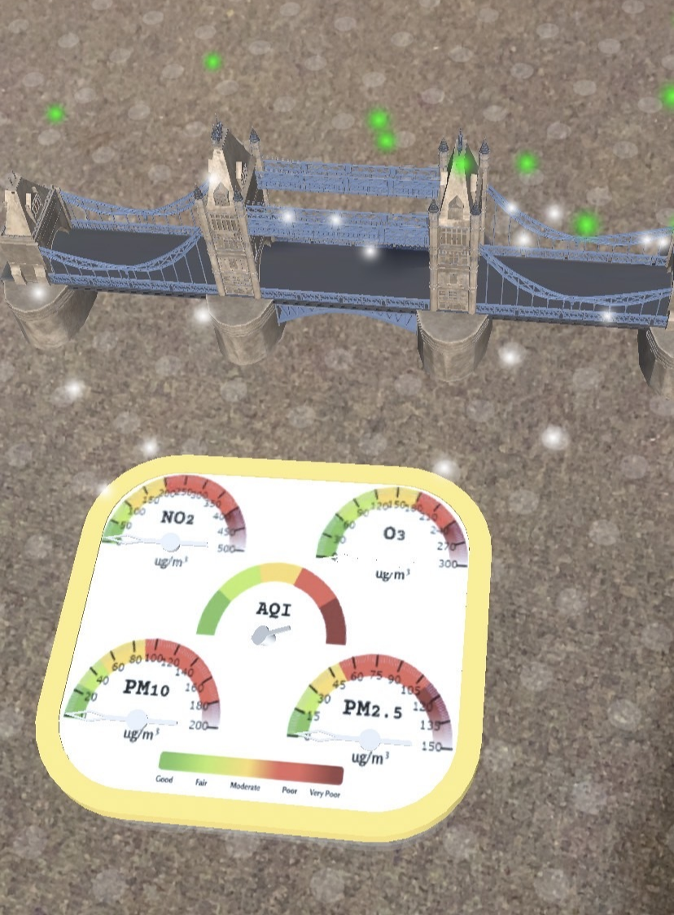
Function Design
AR
The whole scene is an AR scene.
Interact
LondonAQ also provides an opportunity to display the data for various areas by choosing the location on its App, giving more user engagement and evoking people's curiosity.

Slide 5
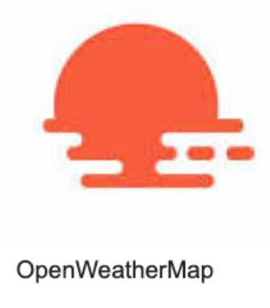
Function Design
real-time data
The data is collected from the OpenWeather API every 10 minutes. Users can see the pointers are sync in physical gauge and the virtual one, allowing users to check the readings wherever and whenever they want.
real data
Data from open weather, which provides real/accurate air quality data.

Slide 6
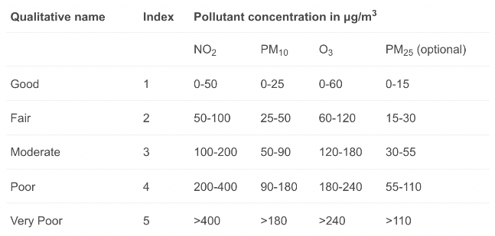

Data Source—OpenWeather
Data
Why do we choose?
Current state with every 10 min update
Provide all weather alerts from the entire world
High accuracy between 90% and 100% with inaccuracy about 1%
What is AQI?
An Air Quality Index (AQI) is used by government agencies to communicate to the public how pollute the air currently is or how polluted it is forecast to become. Public health risks increase as the AQI rises.
Nitrogen dioxide (NO2)
Inhalable particles (PM10)
Fine inhalable particles (PM2.5)
Ozone (O3)
Air Quality Index (AQI)
Data Source:

Slide 7
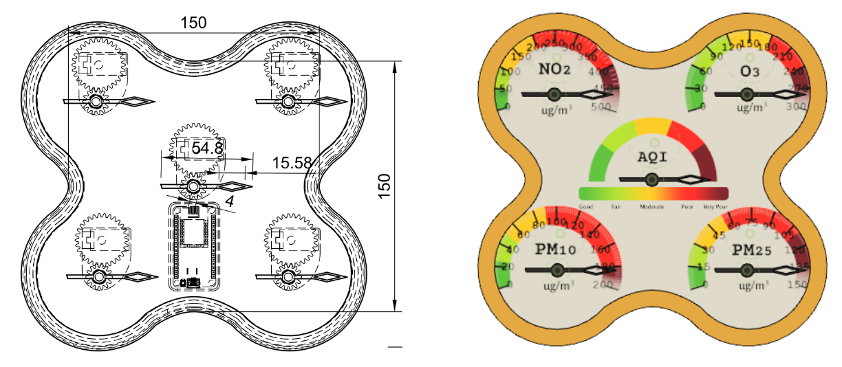
Problems with V1 design?
Node MCU ESP8266 can't drive 5 servo motors
Not necessary to have the dial faces to be over 180 degrees

Slide 8
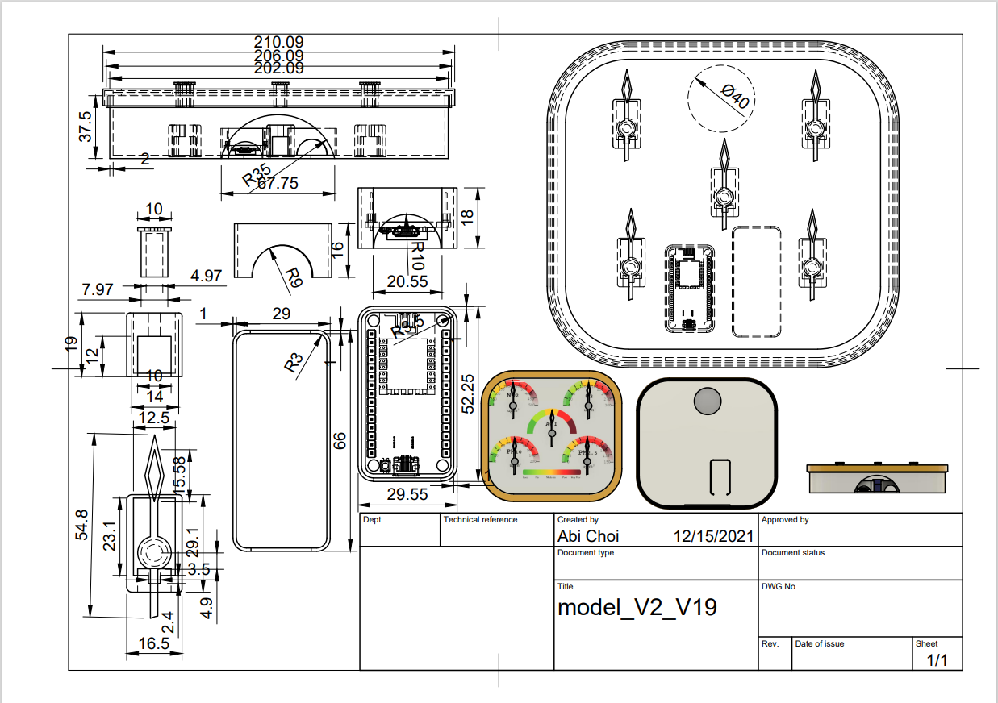
V2 design
The pointers will only turn in 180 degrees
No gears!
A holder is added for the driver

Slide 9
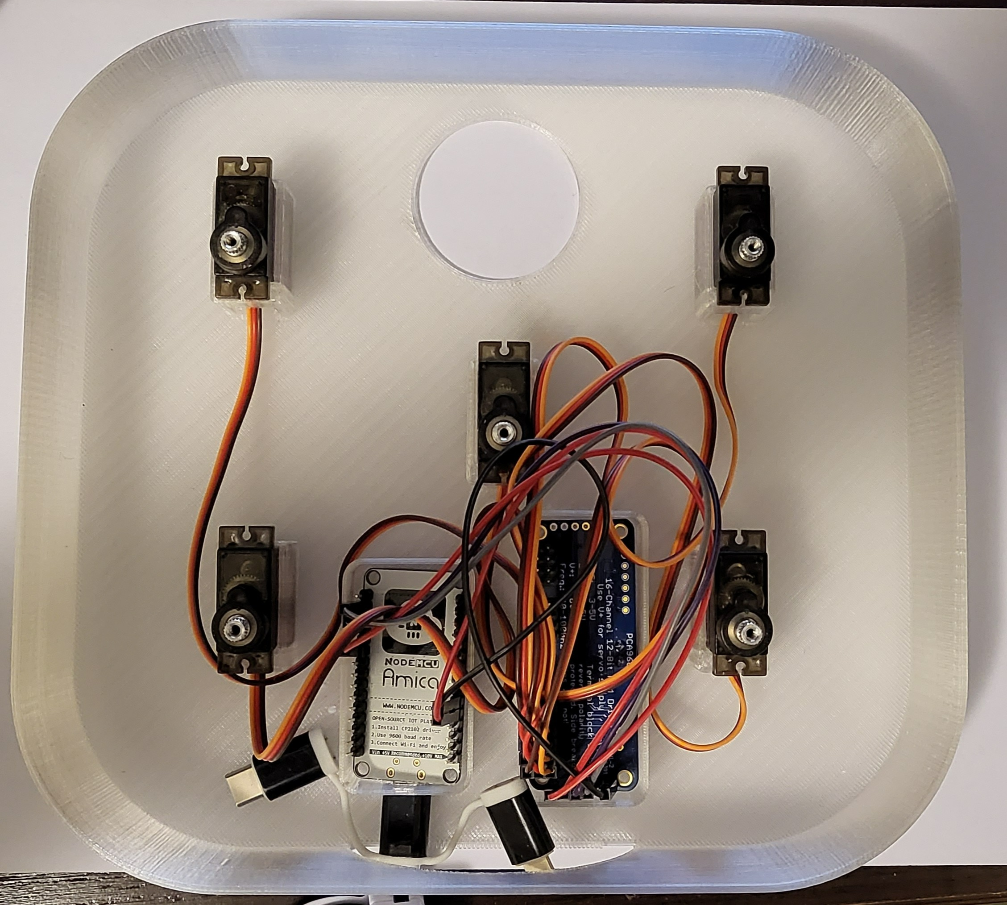
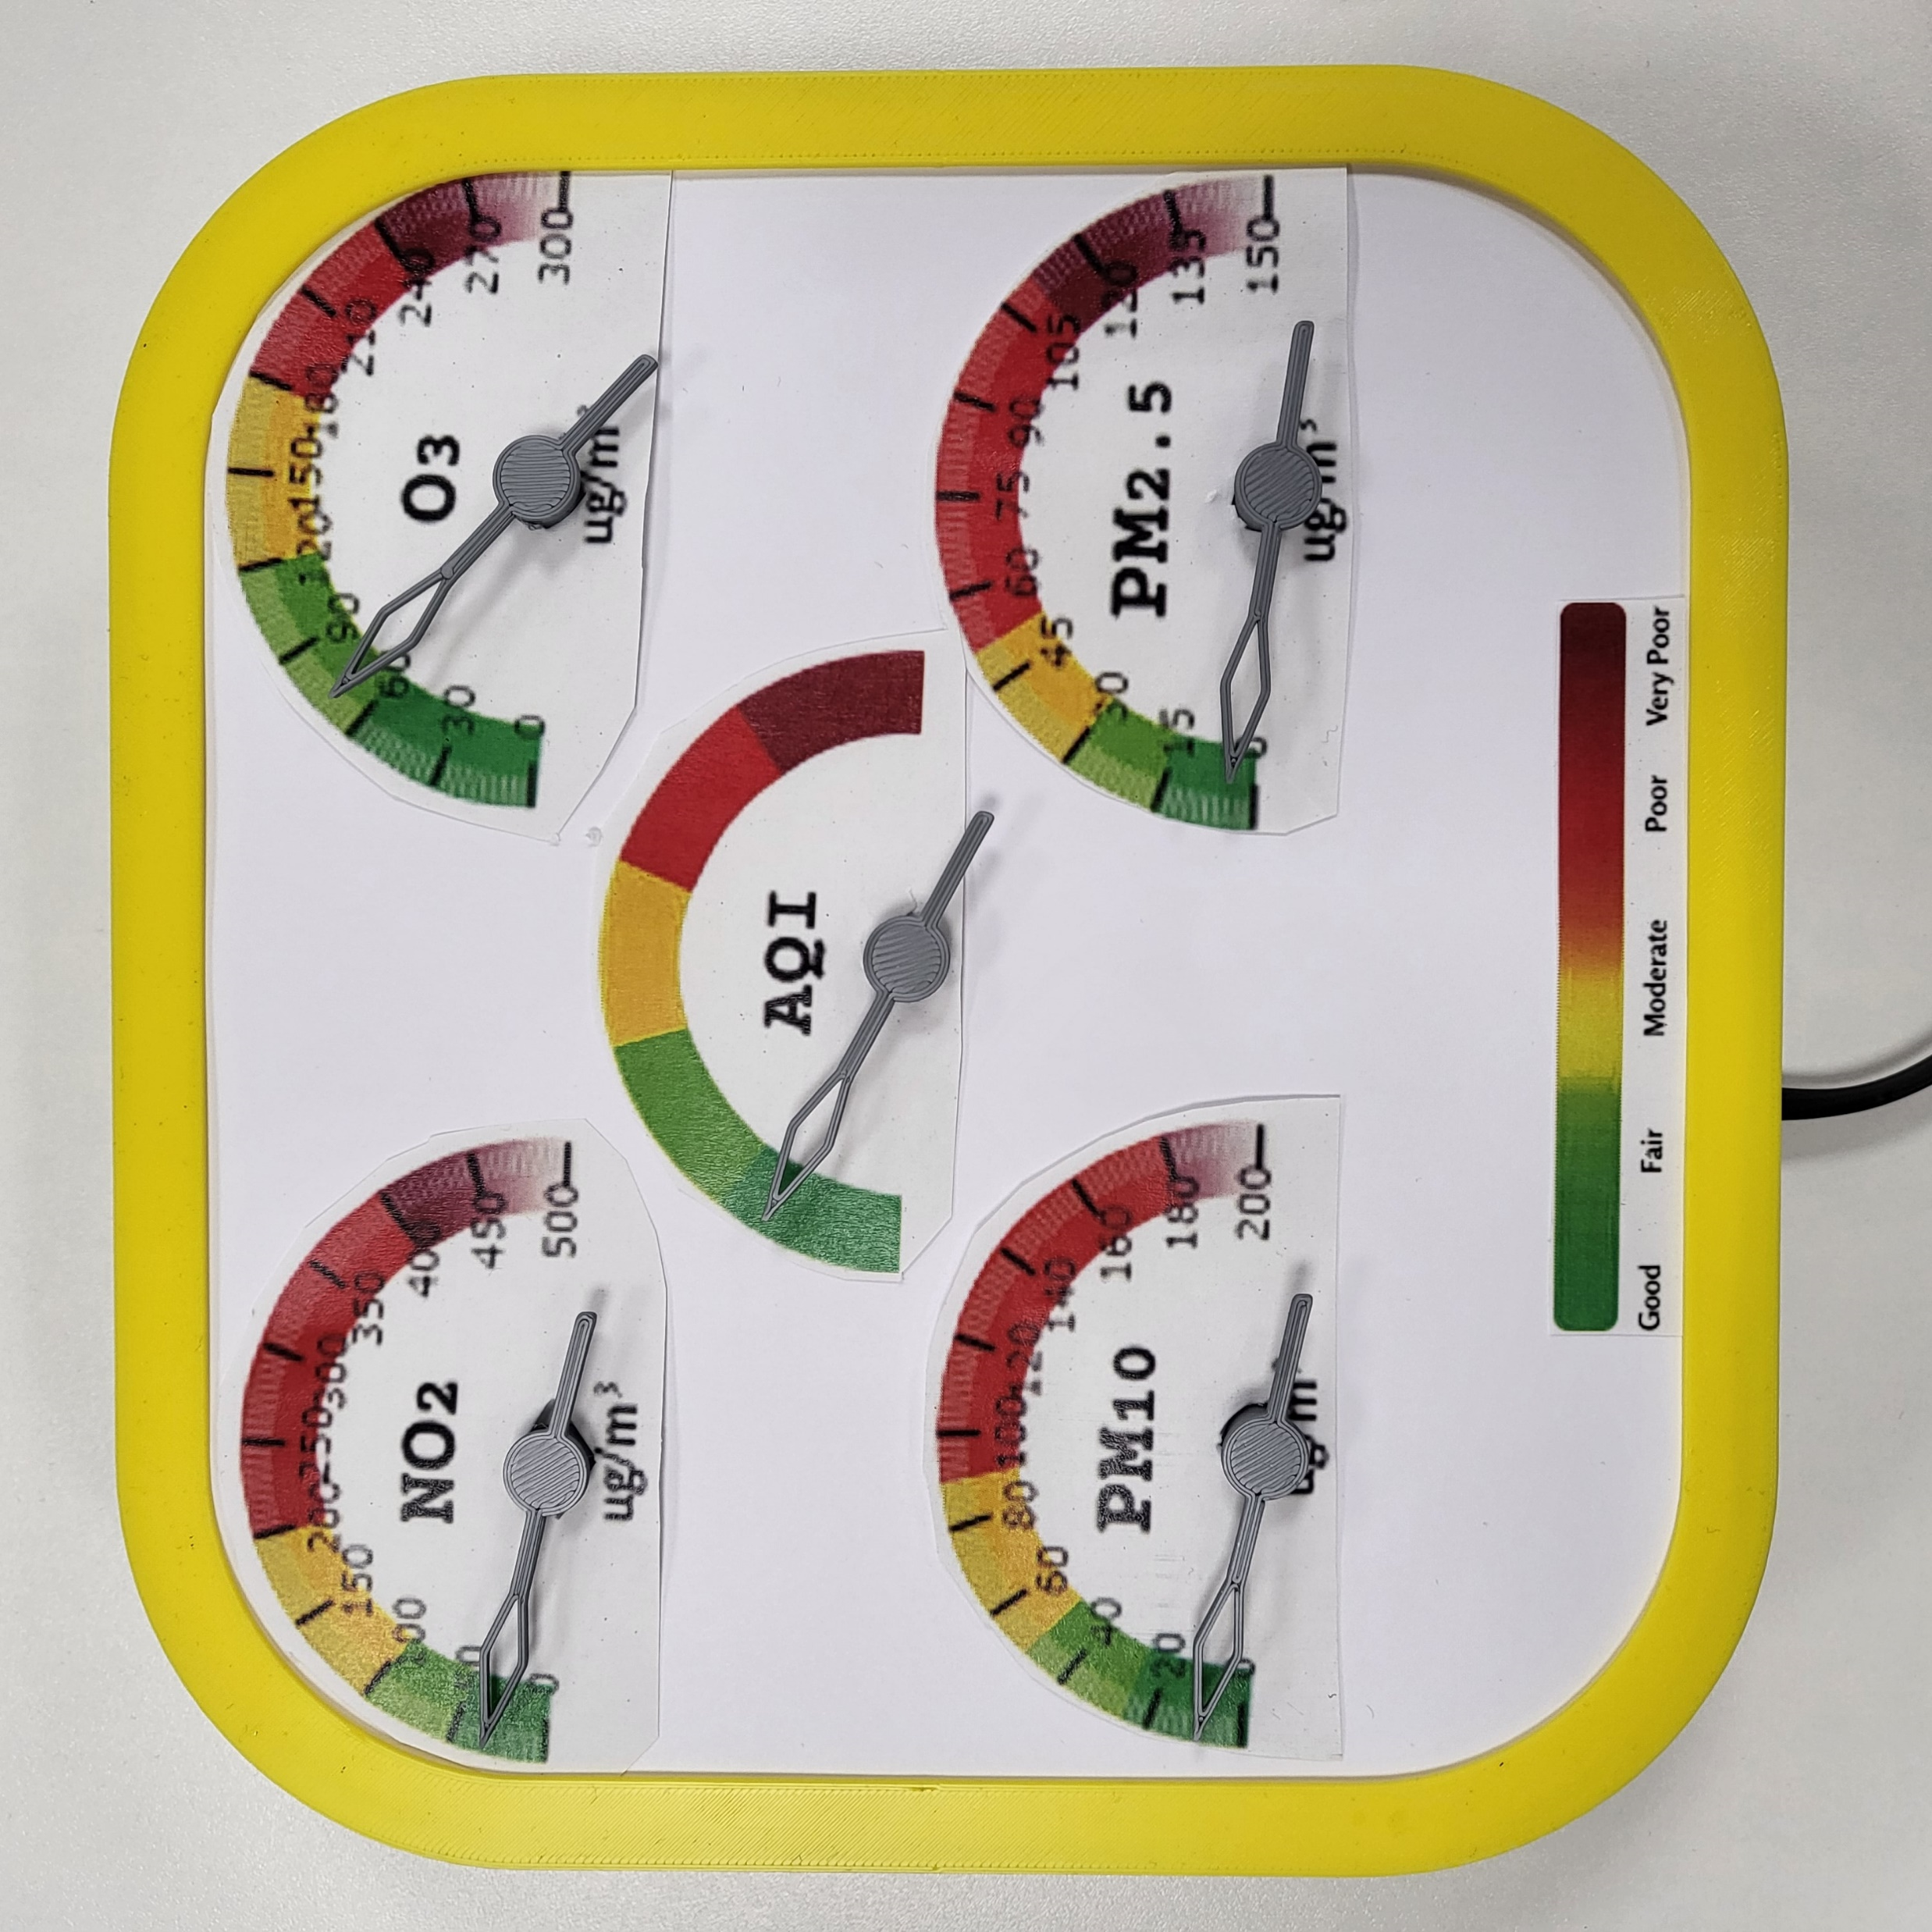
Physical device

Slide 10
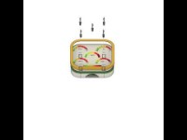
Dissemble
https://www.youtube.com/watch?v=dYxFbuPg1-s

Slide 11
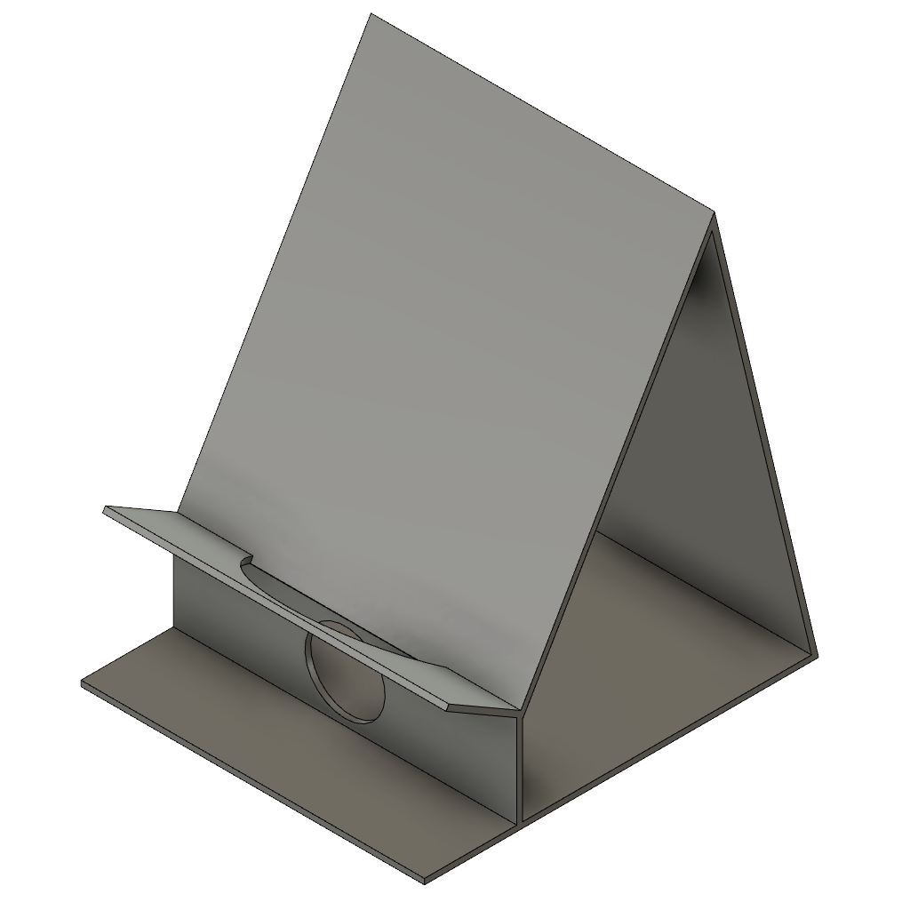
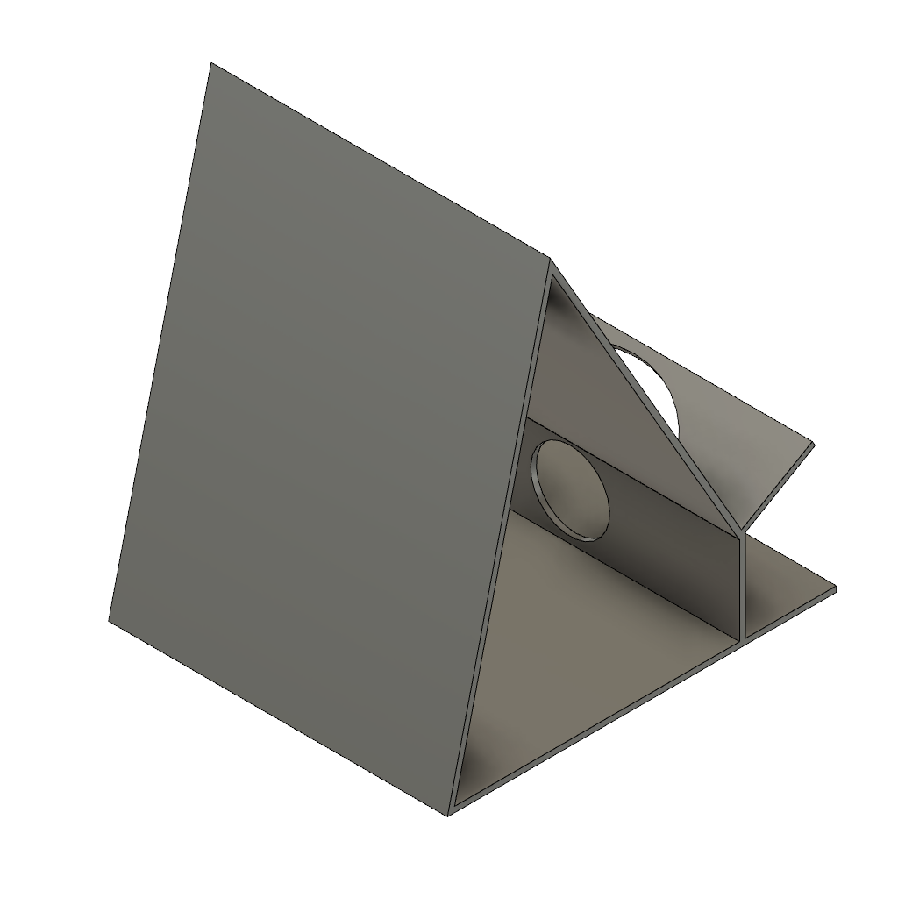
Stand

Slide 12
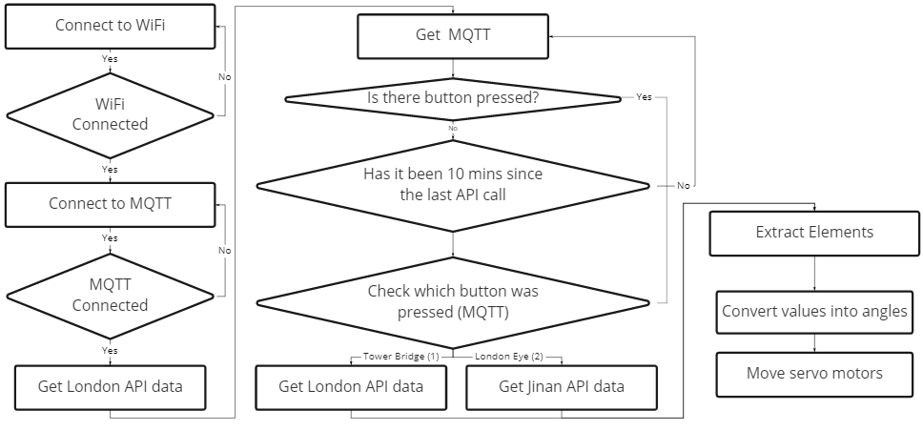
Code

Slide 13
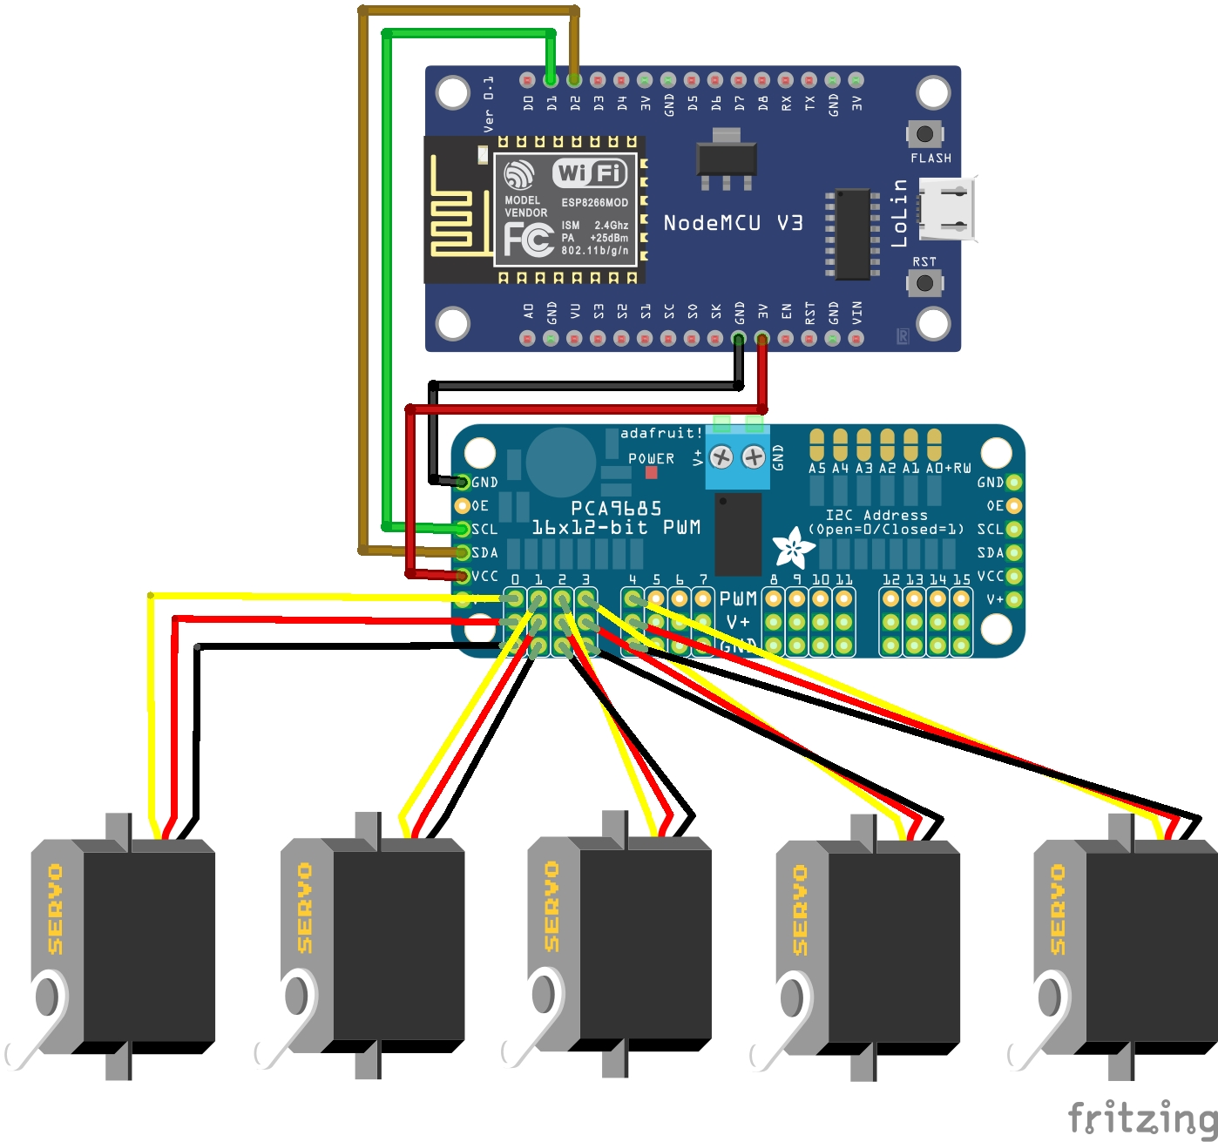
Circuit

Slide 14
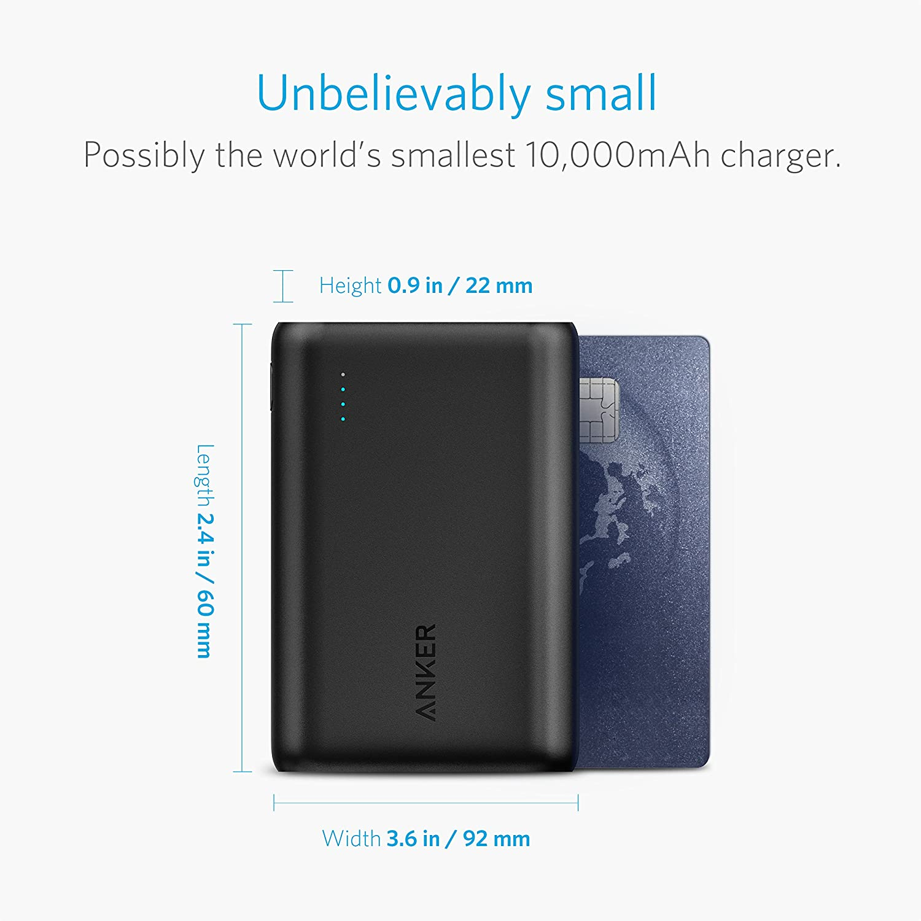
Which one?
 | Arduino Uno WiFi Rev 2 | VS | Node MCU ESP8266
WiFi capability | Yes |  | Yes
Size | 53.4*68.6*15.4 mm |  | 49*24.5*13 mm | Enclosure can be smaller
Enough Ports | Yes |  | Yes
Operating Voltage | 5V |  | 3.3V | Longer operating time
Clock Speed | 16MHz |  | 80MHz
Power bank
AK-A1263011

Slide 15
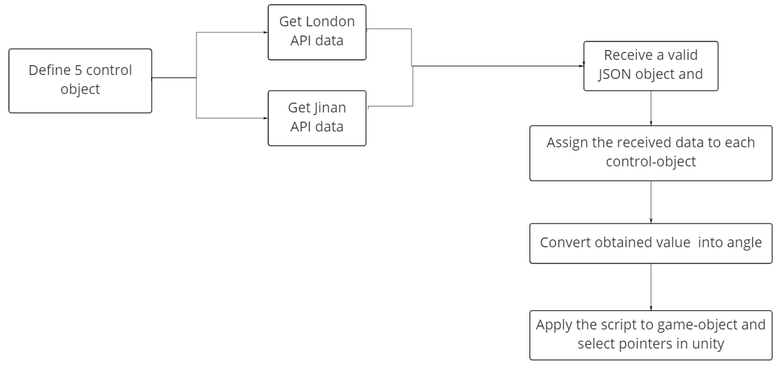
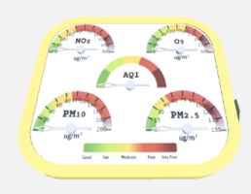
Digital Device: code
AQI
API website:
https://openweathermap.org/api/air-pollution
API call:
http://api.openweathermap.org/data/2.5/air_pollution?lat={lat}&lon={lon}&appid={API key}

Slide 16
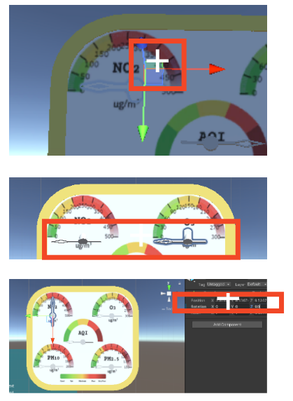
Digital Device: rotation challenge
Cannot rotate along the center of the half circle. The pivot point does not align with the center point
Rotate along which axis (x, y, z)will be correcttest one by one in script
Test through unity Rotation settingsreal-time changes

Slide 17
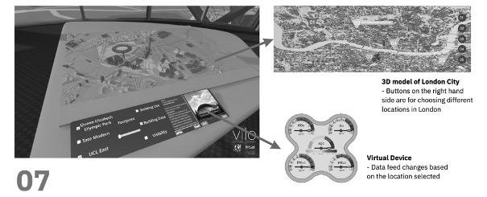
Digital Place: Building process
Mid Crit
Feedback/Reflection
3d model of entire London is too heavy and large for an AR app. (Even though the LOD is 1)
Lack of relationship between London 3d model and virtual device.
-> Use a single 3d landmark as an icon to demonstrate the location of data source

Slide 18
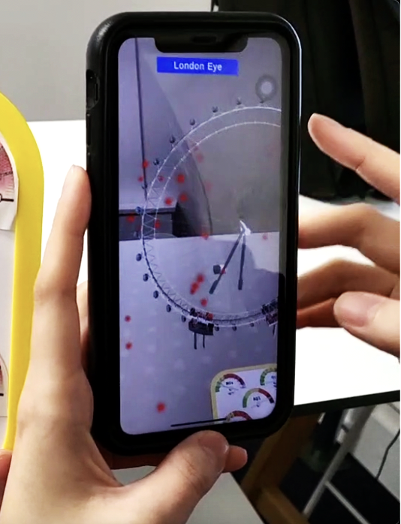
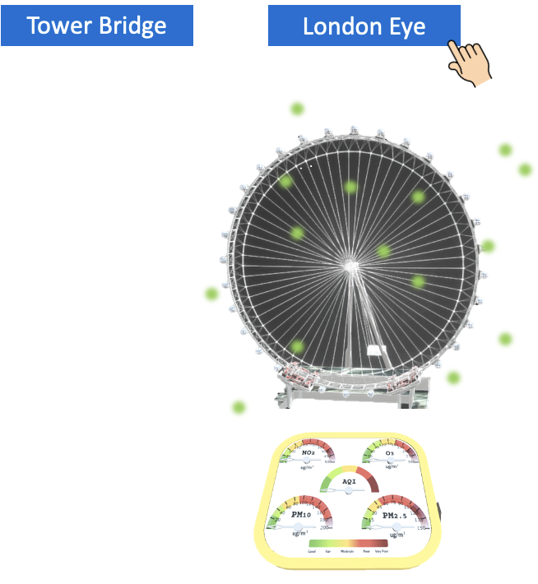
Digital Place: Building process
1
Kanban
3D Landmark + Particle System
Virtual device
2
3

Slide 19
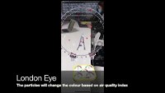
Digital Place: Building process
Demo 1
https://www.youtube.com/watch?v=iRU2Oow9fpw

Slide 20
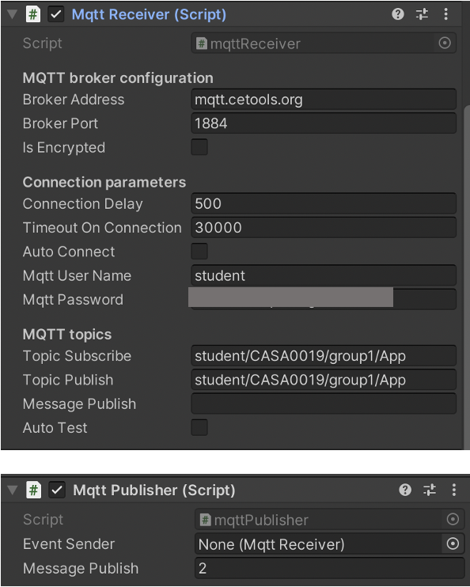
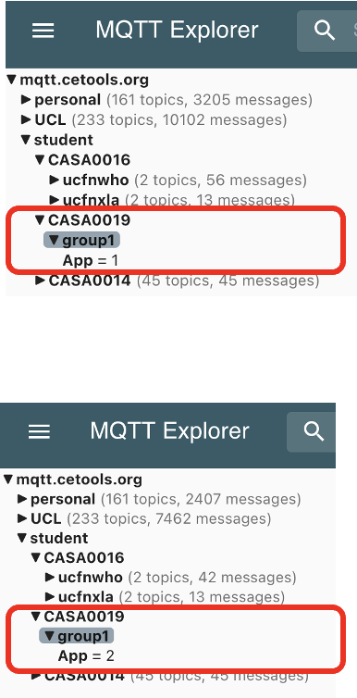
Digital Place: Building process
1
Kanban
If London Eye is pressed
-> OnClick() function
Show London Eye’s model, particles, virtual device
Hide Tower Bridge’s model, particles and virtual device
MQTT publisher
1 = Tower Bridge is pressed
2 = London Eye is pressed
-> Control the physical device

Slide 21
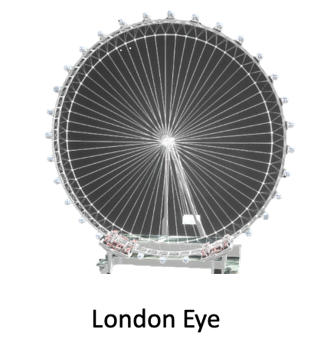
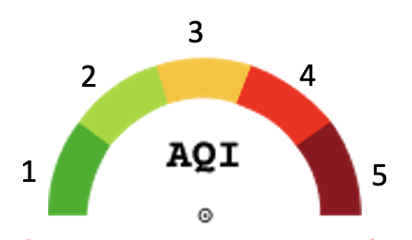
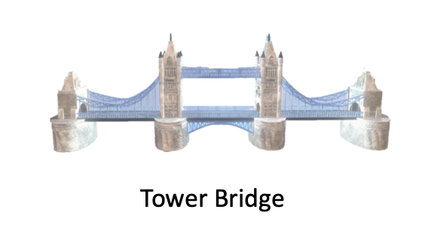
Digital Place: Building process
2
3D Landmark + Particle system
Use existing 3d model resources
360 Panoramic Images – Using cube or sphere projection is not suitable for a single landmark
3D Photogrammetry – Landmark is so large that may need drone to take pictures
Existing 3D model – More feasible
The colour of particles is based on air quality index from API
Set the start colour to white - allow users to see the colour is changing
London Tower Bridge - Buy Royalty Free 3D model by Easy Game Studio (@Jeremy_Zh) [7228cef] (sketchfab.com)
London Eye - Download Free 3D model by Antonio Rodriguez (@tubero44) [5c1c07d] (sketchfab.com)

Slide 22
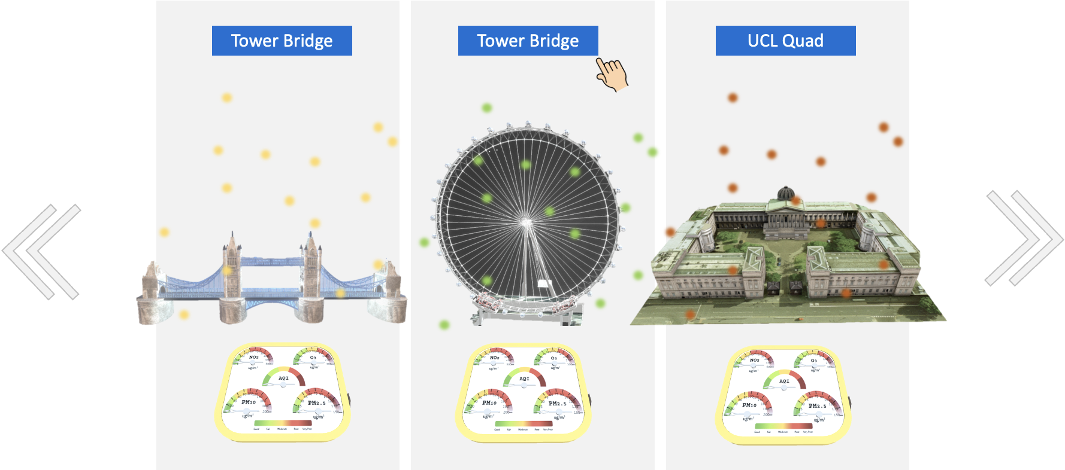
Digital Place: Controlling physical device via AR app
What if LondonAQ wants to demonstrate more data...?
Instead of creating multiple physical devices, LondonAQ is able to change the API request of physical device by using AR app
University College London (UCL) Quad - Download Free 3D model by digitalurban (@digitalurban) [7d33484] (sketchfab.com)

Slide 23
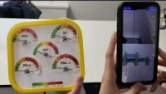
Digital Place: Building process
Demo 2
https://www.youtube.com/watch?v=n2T4Jqz7mTM

Slide 24


Digital Place: Installation package
Android iOS

